Slide 1
The quest of fidgets
Perkedel Technologies:
Joel Robert Justiawan (2101629672)

Slide 2
Introduction

Slide 3
Fidget Quest
Play in unusual way
Uses various forms of controllers
Not just sitting, also stand up
Mysterious! Instructions only, solve yourself.

Slide 4
Inspiration source
Trollface Quest – Spil Games. Core game mechanics
Wario Ware – Nintendo. Action based puzzle solving, known to had been releasing games with many unique ways of controlling
Fidget Spinner – various. This spinning thing is the philosophy of this merchandise, to make user relax and experience something new.

Slide 5
Features
Various ways to control
Loads various memes such as sounds, image, and more
Hilarious level results
Boring level results
2D or 3D? Whatever!
Crossover! Multiplayer across different devices, different software, throughout the internet! Spoiler alert: Fidget Quest X Hexagon Army! VR Hexagon, and Conventional Fidget playing together
What is it?
Create your own (real release)
More DLC! Gratis only if you are Linux user.
Exclusive reward for Linux user: All save data and DLC are saved in $HOME directory! Do anything you can there!
Proprietary platform user: All save data and DLC are saved in program files. Lose OS, lose save and DLC. No cloud saves allowed. Even if you attempted to manual download DLC and place them in %appdata%, the game will ignore it.
NO Digital Restrictions (Rights) Management AT ALL!!! It’s all yours.
Just to name few

Slide 6
Characters
Fidget Cube. Main protagonist of this merchandise. He is a robot cube with general robot face consists of dual camera, scent receptor, OLED display mouth, and stereo speakers beside the mouth. On the side, he has hands, stereo microphones. This cute little thing is the one you carry along your adventure.
Other characters that comes from every DLC. Even you can import from the other games such as Hexagon Army/Engine (The Yellow Raincoat Group)

Slide 7
Target
Audience: depends on each season. Default is all age.
Platform: Linux (high priority), Android, Windows, Apple, whatever...
Player counts: depends on each season, either single or multi.
Connections: Optional.
Stuffs: mixed between free and original assets
License: Software is GNU GPL v3; Documents, music, images is CC4.0-BY-SA; Unless noted by the authors on the credit screen.

Slide 8
Concepts

Slide 9
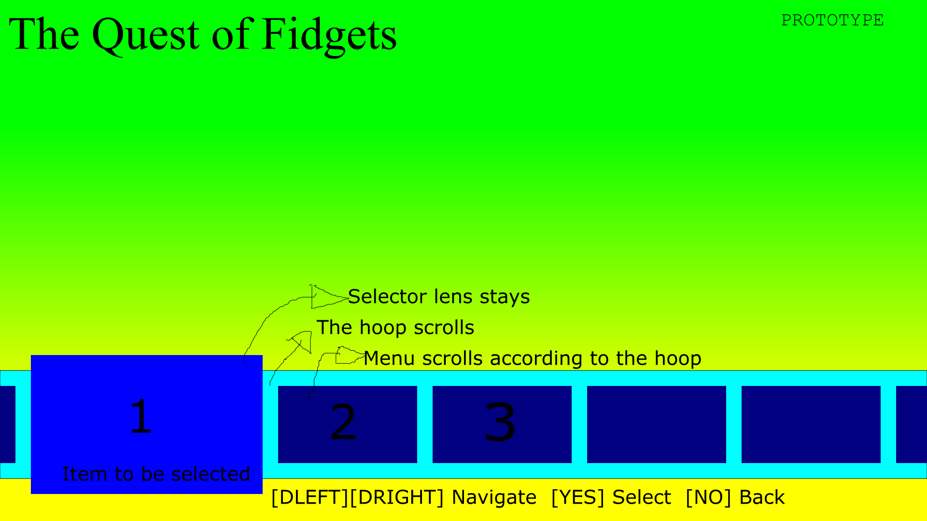
Main menu

Slide 10
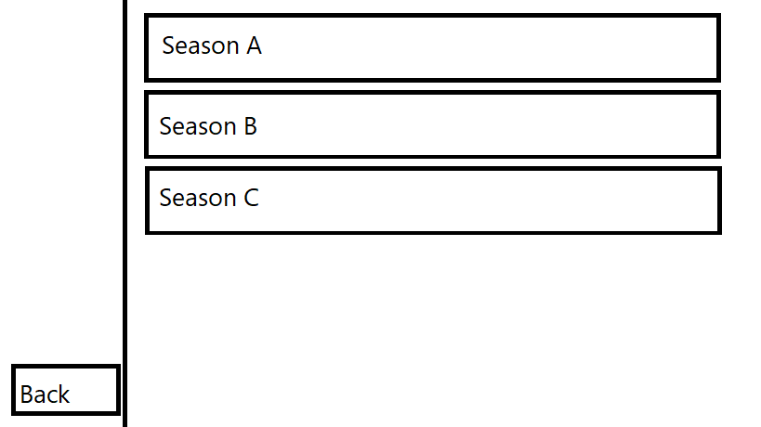
Select

Slide 11
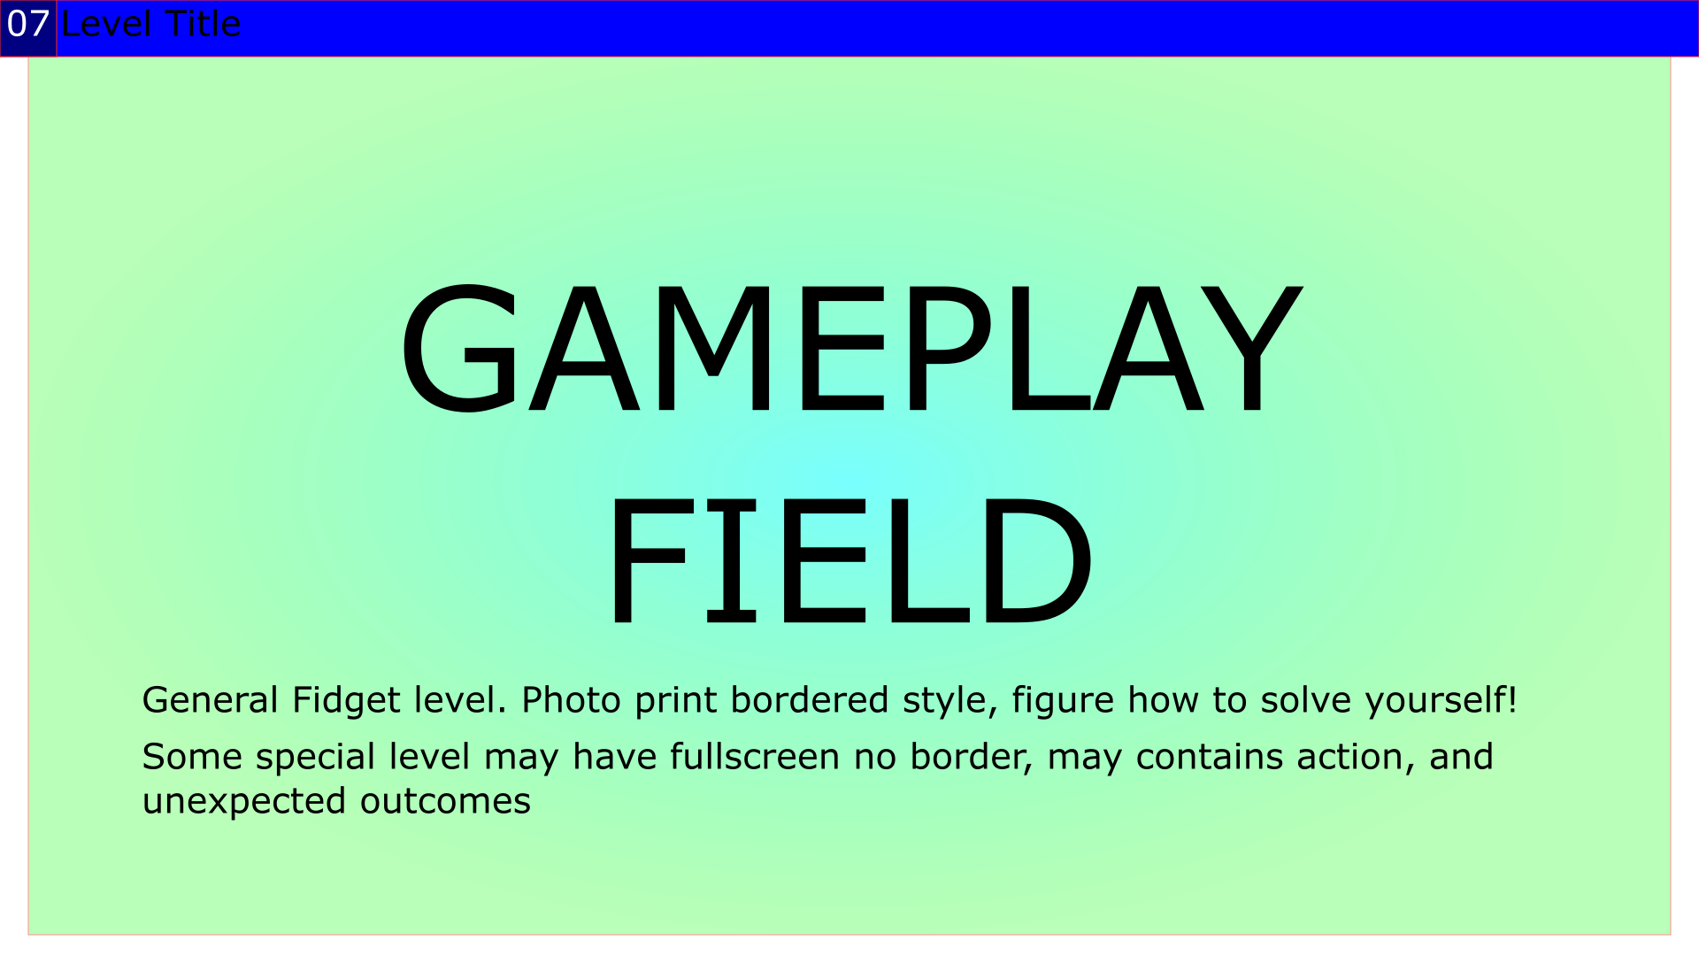
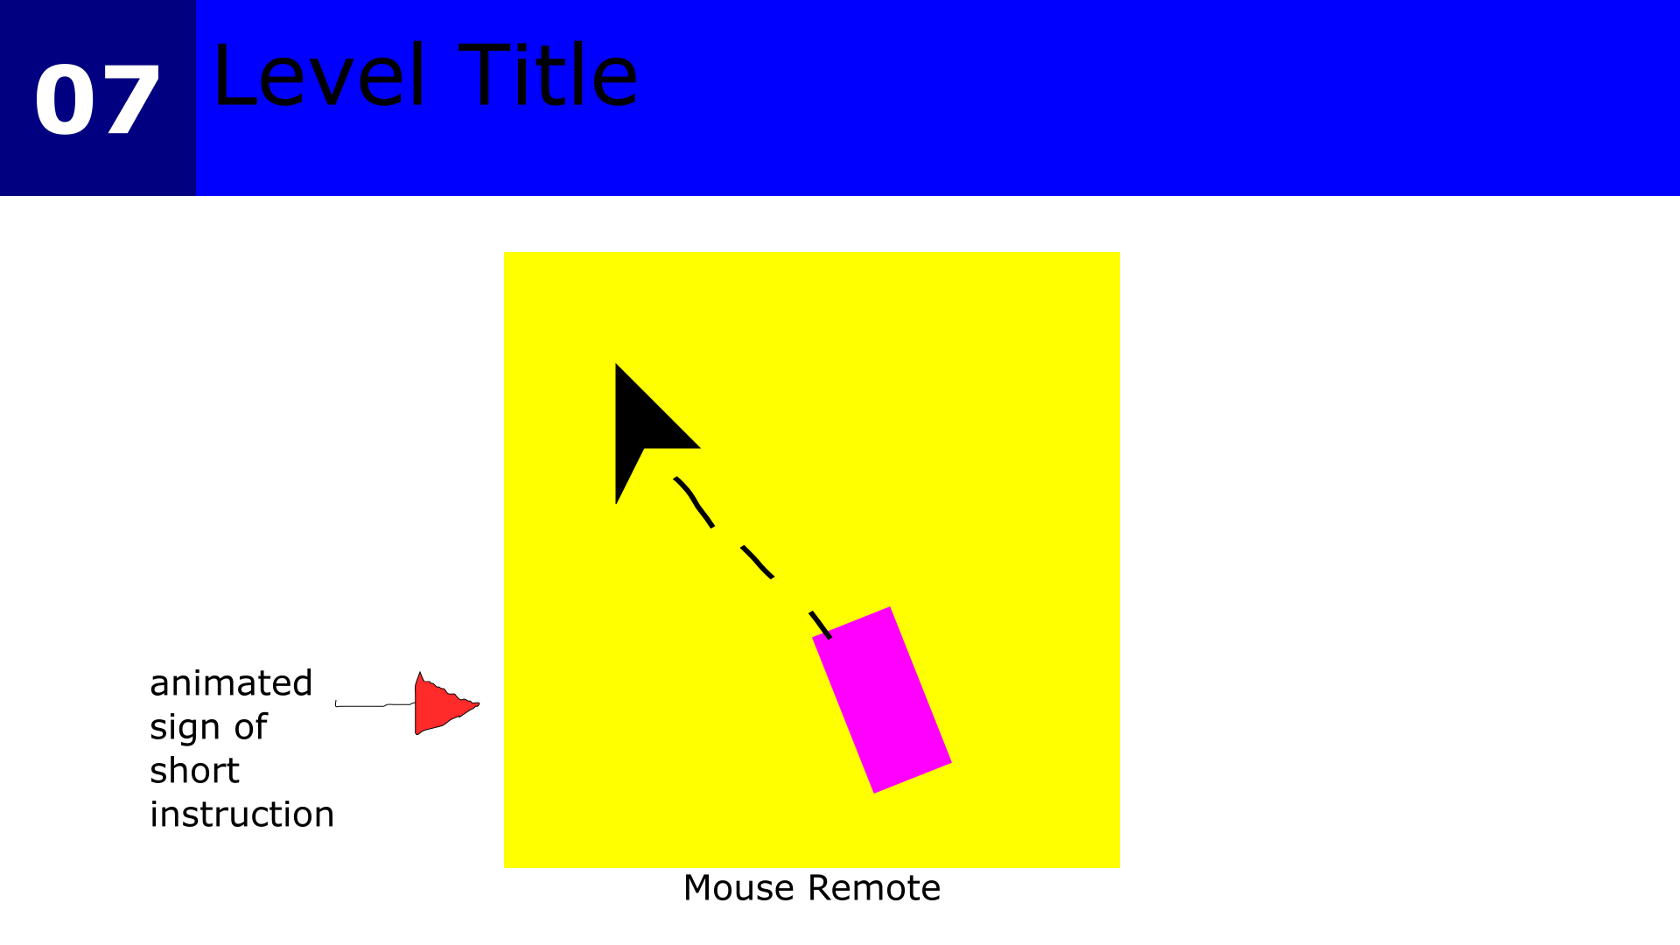
Gameplay

Slide 12
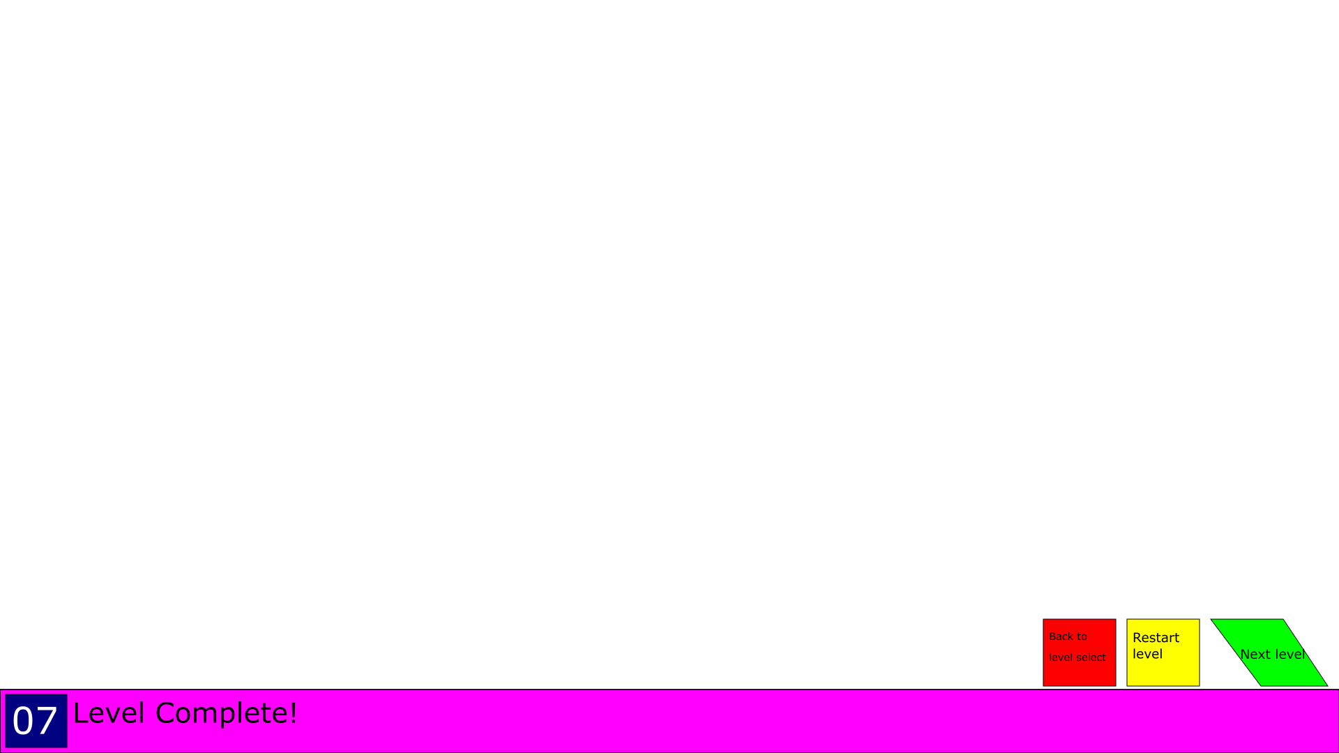
Level complete

Slide 13
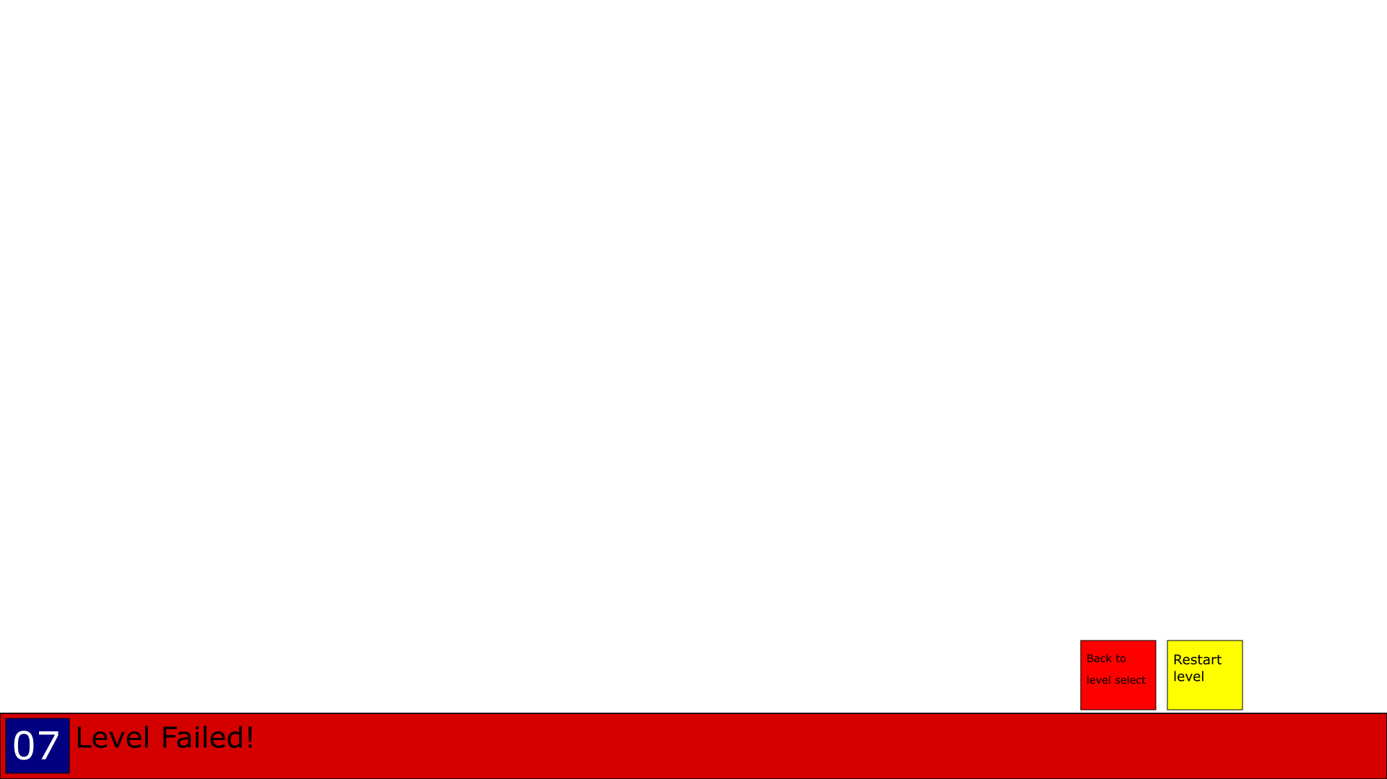
Level failed

Slide 14
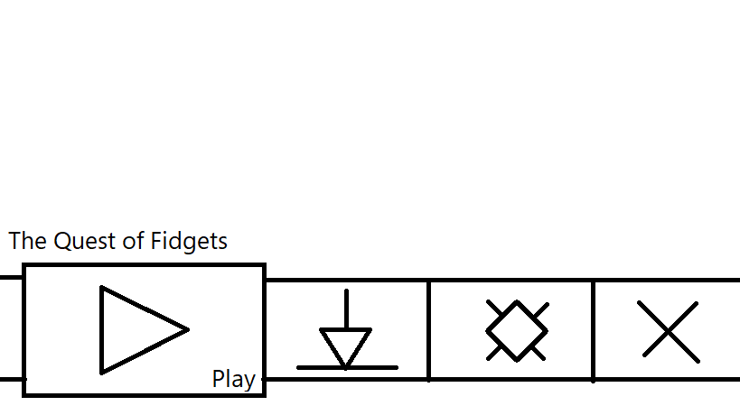
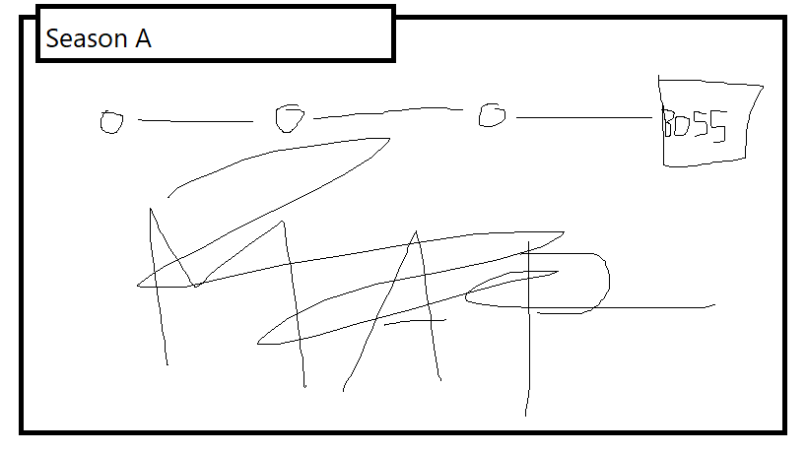
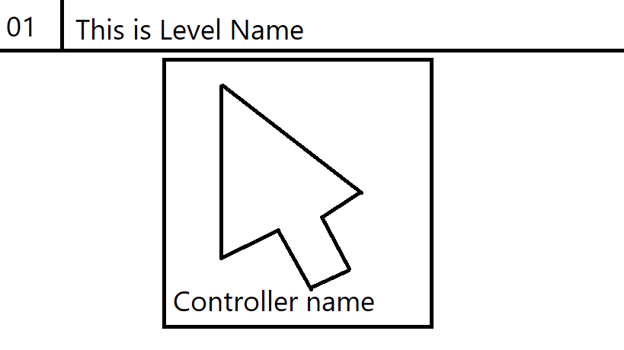
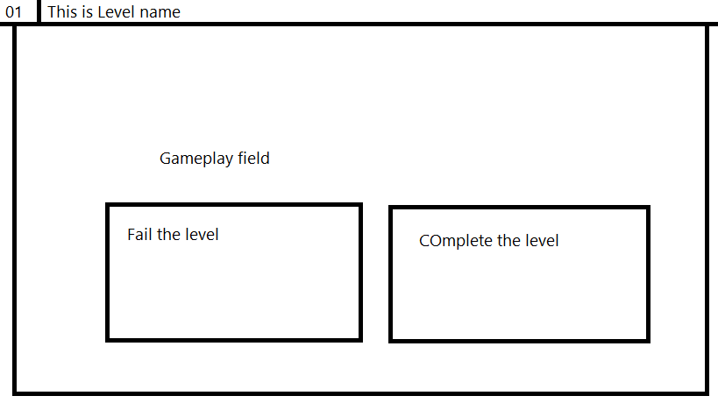
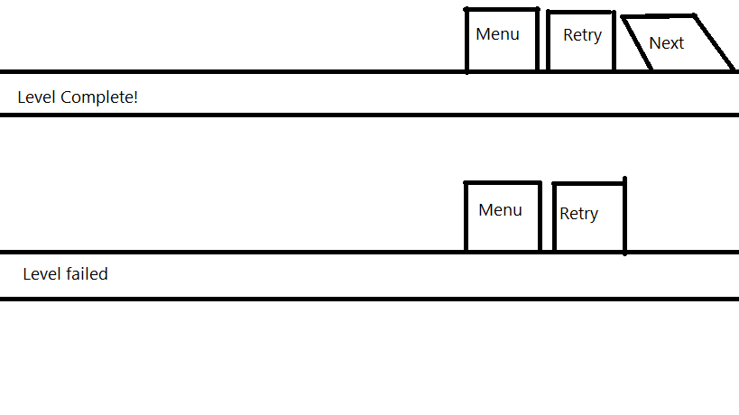
Hmst’d’ve...

